Slide 1
Incidence of suicide over time - How to turn the tide?
Prof dr Bert van Hemert
Leiden University Medical Centre
Department of Psychiatry

Slide 2
Incidence of suicide over time
71 years of Dutch suicide data
(CBS 1950 – 2021)
36 years of National suicide prevention policy (1986 – 2022)
Presentation of numbers over time
in relation to policy
/19

Slide 3
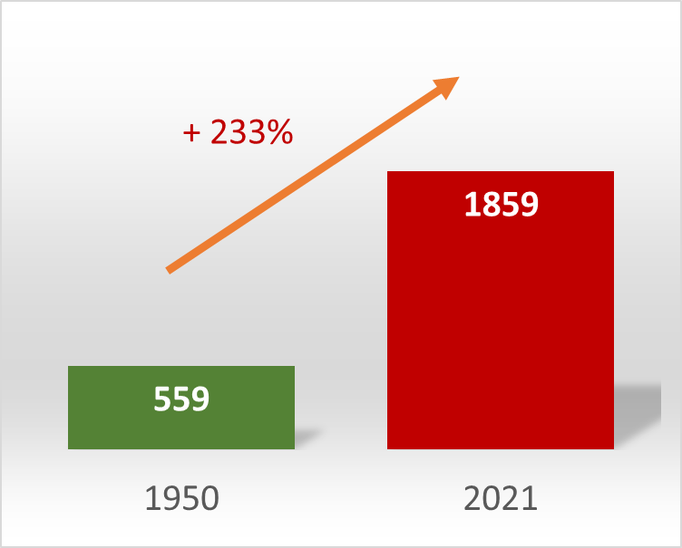
Total number of suicides 1950 - 2021
/19

Slide 4
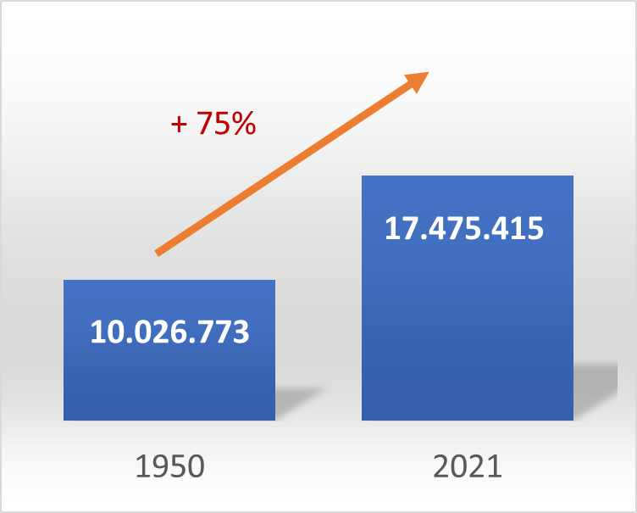
Population growth 1950 - 2021
/19

Slide 5
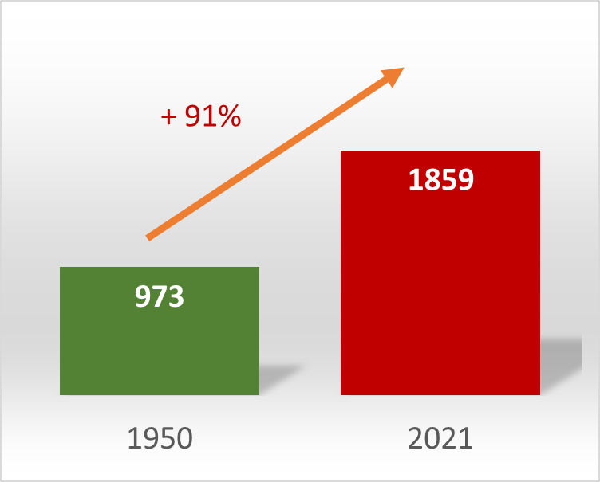
Number of suicides – Adjusted for population growth
/19

Slide 6
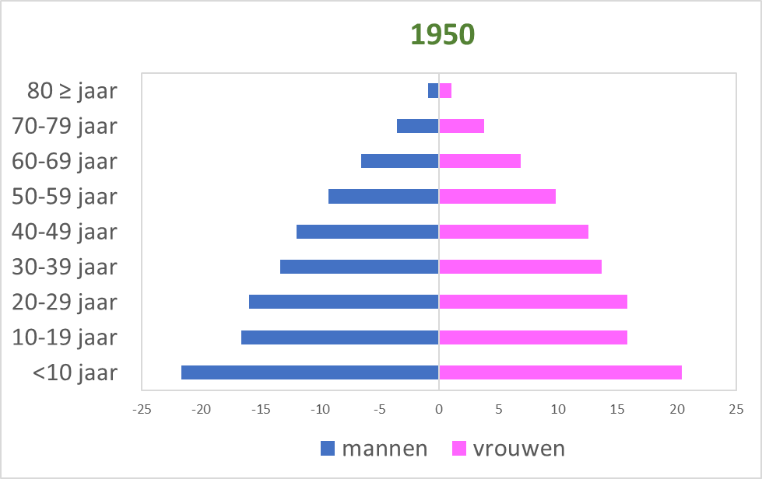
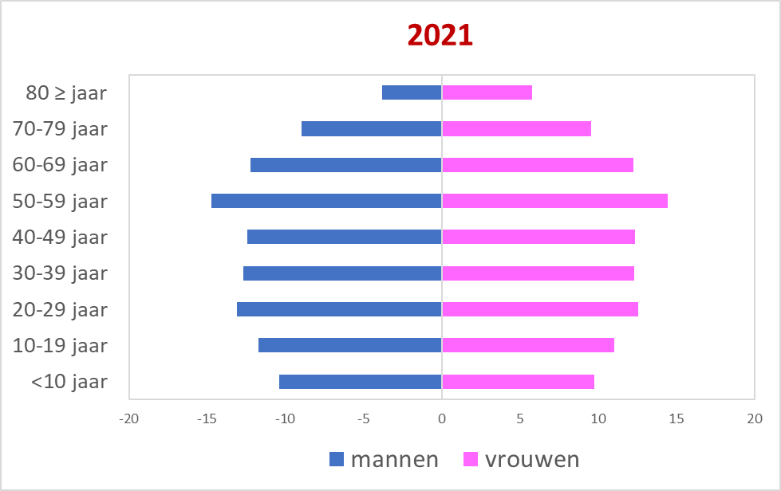
Population pyramid 1950 - 2021
/19

Slide 7
Relationship with age and gender
/19

Slide 8
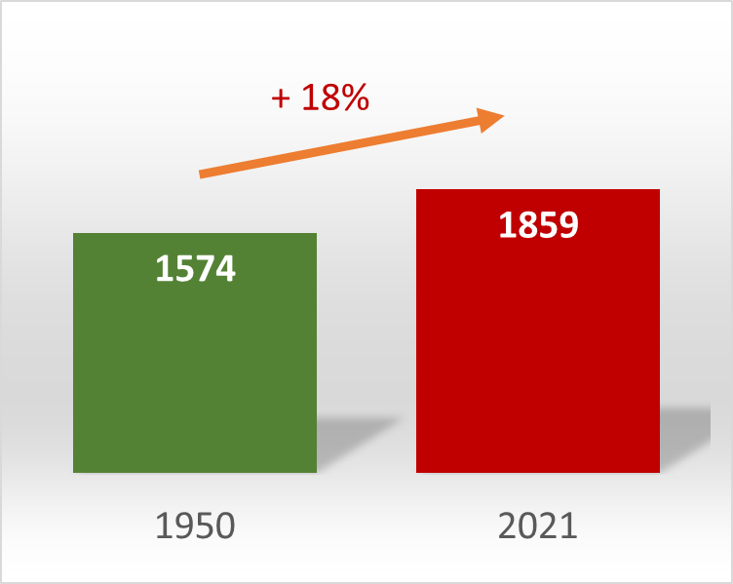
Number of suicides – Adjusted for population and age distribution
/19

Slide 9
Adjusted suicide incidence 1950-2021
/19

Slide 10
Adjusted suicide incidence 1950-2021 – 5 year moving average
/19

Slide 11
Trends in suicide incidence 1950-2021
1968
1984
1992
2008
2015
/19

Slide 12
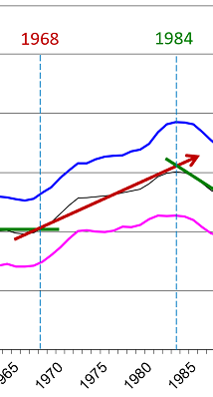
National suicide prevention policy 1968-1984
???
Dutch prime ministers
Zijlstra, de Jong, Biesheuvel, den Uyl, van Agt
America
Nixon, Carter, Reagan
End of US involvement in Vietnam (1974)
Popular music
Beatles - White album (1968)
Talking heads – Stop making sensen (1984)
Economy
Steady growth in stock market; Inflation 4 – 14%
/19

Slide 13
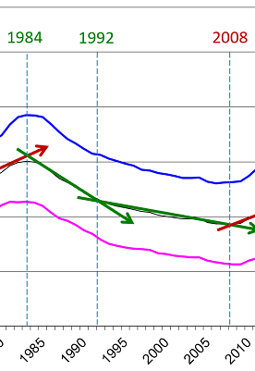
National suicide prevention policy 1984-2008
1984 WHO-policy signed bu European countries
1986 National Health council report on suicide
Dutch Policy
Suicide prevention is considered a primary task of mental health care
Focus on improving mental health care
National reorganization of ambulatory care (RIAGG, starting 1982)
1991 First consensus guideline suicide prevention
Economy
Ups-and-downs – 2000 bursting of tech bubble
/19

Slide 14
National suicide prevention policy 2008-2015
2007 – Revision of national Health council report
2009 – Start 113 (online) Suicideprevention
2010 – National policy recommendations
2012 – Multidsciplinary guideline diagnosis and treatment of suicidal behavior
National policy
2014 – First National Agenda Suicide prevention (300k/year)
Economy
Financial crisis
/19

Slide 15
National suicide prevention policy 2015-2021
National policy
2014 – First National Agenda Suicide prevention (300k/year)
2018 – Second National Agenda (1.200k/jaar)
2021 – Third National Agenda (4.800k/jaar)
/19

Slide 16
Third National Agenda Suicide prevention
2021-2025
Together Less Suicide
Integrated approach
Signed by more than 50 organisations
Universal, targeted and individual approaches in 30 projects
Both evidence- en practice based
Commissioned by Dutch governement
Coordinated by 113 Suicideprevention
6 Ministeries, Inspection, municipalities
Care institutions, client- and family organisations, insurrance companies
Educational organizations (MBO, HBO, WO)
Social-economic sector: social securiy services, debt counceling services
Police, national railways

Slide 17
Togehther Less Suicide
Main target: reduce the total number of suicides and suicide attempts in the Netherlands
Focus of change 1
Dare and learn to talk about suicide
Focus of change 2
Probe further and help seeking help
Focus of change 3
Secure and optimal helath care
/19

Slide 18
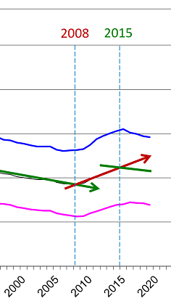
To take home
Change in suicide numbers is slow
Focussed national efforts in suicide prevention have started only recently
Will we turn the tide ….
/19

Slide 19
… together?
/19

