Slide 1
Managing suicidal behaviour in the era of non-restraint, 1850 – 1890
“Under the constant charge of a special attendant”
Dr Sarah Chaney
Royal College of Nursing & Queen Mary, University of London
Notes:
Content warning

Slide 2
INTRODUCTION
Henry W., 47-year-old clerk, admitted to Bethlem in May 1865
A few days after admission, Henry tore open his wound: ‘an attendant on either side never leaves hold of his hands’.
Early June: ‘not safe to leave hold of his hands for an instant. He is looking ill and sedatives have very little effect on him.’
Notes:
In May 1865, Henry W., a 47-year-old clerk was admitted to Bethlem after attempting to cut his throat. A few days after admission, Henry tore open his wound. It was sutured and a special watch arranged. Yet two days later Henry managed to injure himself again. After that ‘an attendant on either side never leaves hold of his hands.’
By early June it was still ‘not safe to leave hold of his hands for an instant. He is looking ill and sedatives have very little effect on him.’ This month of constant hand-holding is unsettling: it’s hard to imagine just how unpleasant this must have been for Henry W. Did the attendants also become frustrated by their distressing task? 30 years earlier, Henry W. would probably have been restrained in a strait-jacket or other garment. What had changed by the 1860s that this didn’t happen? And what impact did this have on asylum nursing staff?

Slide 3
TABLE OF CONTENTS
01
02
03
04
THE NON-RESTRAINT ERA
NURSING SUICIDAL PATIENTS
THE RETURN OF RESTRAINT
CONCLUSION
What was it and what impact did it have?
The effects of non-restraint on caring for suicidal patients
Why did restraint return in the 1880s and what can that tell us about asylum nursing?
What can we learn from the non-restraint era?

Slide 4
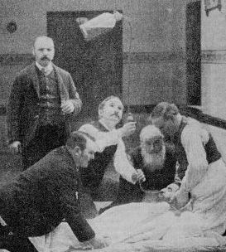
01:
THE NON-RESTRAINT ERA
Notes:
Why is the non-restraint era significant?

Slide 5
Introduced by Robert Gardiner Hill in 1838 at Lincoln Asylum
Adopted by John Conolly at Hanwell and widely publicised
By 1850, all asylums in England and Wales claimed to have abandoned all forms of mechanical restraint
Peculiar to England and Wales (and Scotland)
Notes:
Introduced by Robert Gardiner Hill in 1838 at Lincoln Asylum (didn’t come out of nowhere).
Adopted by John Conolly at Hanwell and widely publicised. By 1850, all asylums in England and Wales claimed to have abandoned all forms of mechanical restraint. Image shows the billiard room at Bethlem in the 1850s.
Peculiar to England and Wales – European and American psychiatrists were sceptical that English asylums were really following this process, and raised concerns about increases in seclusion.
Yet, as we’ve seen in the intro, the non-restraint movement raised particular concerns about care and treatment of suicidal patients. How did this affect the expectations on nurses?

Slide 6
STAFF/PATIENT RATIO
Notes:
Non-restraint required increase in staff. According to Louise Hide, it was not unusual for asylums to have 1 staff member for 50 patients prior to 1840!
Staff to patient ratio at BRH. Most public asylums ranged from 12-20 patients per staff member.
BRH remained fairly constant, at an overall level of around 6 to 1 for men and 6.5-7 to 1 for women. Of course, this is based on the overall numbers of staff – not all staff were working at all times.

Slide 7
ASYLUM ATTENDANTS
WORKING CLASS
HIGH TURNOVER
LITTLE TRAINING
Many men were ex-military, asylum work a job of last resort
Poor conditions and seasonal opportunities elsewhere
1885 MPA Handbook
1890 Certificate of Proficiency in Nursing
Notes:
For much of the second half of the 19th century, mental health workers were referred to as attendants, not nurses – though towards the end of this period, female attendants began to be called nurses.Attendants tended to be working class. They were not well paid. Men were often ex military, employed for their strength. Others were seasonal workers – they would turn to the asylum when they had no other work.
There was a high turnover for both sexes. Women often left to get married, men for opportunities elsewhere. The work was hard, the hours were long, and all nurses were expected to live onsite, apart from married men.
Training was limited and on the job. In 1885, the MPA brought in a textbook for mental nurses, and in 1890 brought in a certificate, to be studied for on the job. Take up varied, depending on the institution and experience. 1892 Bethlem Annual Report: “Two attendants and two nurses passed the examination for the nursing certificate of the Medico-Psychological Association. Several more attended the classes, but postponed going in for the examination. It has been a matter of some difficulty to persuade senior attendants to face an examination, though they attend classes willingly.”

Slide 8
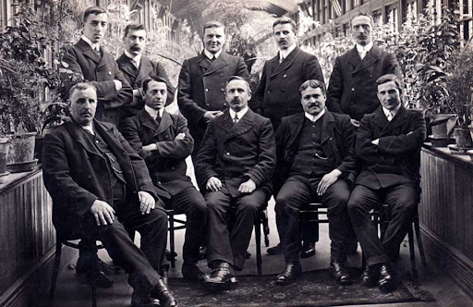
02
SUICIDAL PATIENTS
The impact of non-restraint on nursing
Notes:
Photograph of male attendants at Stanley Royd Asylum, Wakefield, 1910.

Slide 9
CONSTANT WATCHING
“Some of these cases are most determined in their efforts to attempt self-destruction and are only prevented from effecting their object by constant watchfulness on the part of the Attendants.”
Bethlem Royal Hospital Annual Report, 1867.
Notes:
How to spot suicidal patients? Psychiatrists liked to claim their professional knowledge enabled them to spot the “truly” suicidal. Cards written for suicidal patients.
Emma R., admitted in 1857 with puerperal mania (photograph: Henry Hering 1857/8). See extra hand.
We’ve already seen in the case of Henry W. that manual handling of patients was employed in this period. This would have led to even greater short staffing in the rest of the ward.
Attendants automatically suspended after a suicide until the next meeting of the house committee. Inquest into every suicide.
Usually – though not always – attendants found not to be at fault. Yet this constant watching with such a high number of patients must have been draining.

Slide 10
Expected to maintain order and cleanliness on the wards
Domestic comforts: carpeting, cocoa-nut matting, chairs, couches, tables and “modern wooden bedsteads”
Extra challenges: “The use of knives and forks has been continued without any accidents”
Notes:
Alongside this, they were expected to maintain order and cleanliness on the wards – the Commissioners in Lunacy always complained about the want of care if patients were seen to be improperly dressed or dishevelled.
In 1854, Hood reported having introduced carpeting, cocoa-nut matting, chairs, couches, tables and “modern wooden bedsteads” which “completely changed the character of the wards and imparted to them an air of domestic comfort which is so keenly appreciated by all classes of the English.”
The increase in domesticity caused extra challenges – more items that could be used by someone to harm themselves. Bethlem 1851 annual report: “The use of knives and forks has been continued without any accidents”. Of course, this added an extra duty to the work of attendants. Utensils needed to be counted and locked away after every meal, to prevent patients taking them away.

Slide 11
“…daily his various Table d’Hôte dinners and teas, for which he finds his various arrangements now successfully carried out and an increased tone of life and cheerfulness...”
—James Adam, Crichton Royal Institution, 1880
Notes:
The middle class ideals of superintendents introduced new challenges, so determined were they to create a domestic atmosphere in the wards. At the Crichton Royal Institution in Dumfries, James Adam introduced ‘Table d’Hote’ dinners in both the private and pauper wings of the asylum. Here the patients would dine together, on the ward. An attendant was expected to carve the meat at the table, a special spring-loaded drawer on hand into which they could lock the carving knife should any trouble arise.

Slide 12
LIFE IN THE ASYLUM
“On the morning of 1st June she still appeared better, had a good breakfast about 8 o'clock and afterwards assisted with some domestic duties. An attendant noticed her soon after nine o'clock carrying some sheets down the Gallery. Very soon after she was missed and a search resulted in finding her in one of the single bedrooms with her throat cut. She was dead, both carotid arteries having been divided. An attendant’s dinner knife belonging to Margaret Wilkins was lying by her side.”
Suicide of Emma C. at Bethlem Royal Hospital, 1865
Notes:
Attendants also lived alongside their patients. They often used the same facilities, cooking their lunches on the wards and using the same bathrooms. In 1865, nurse Margaret Wilkins was temporarily housed in an ordinary patient's room while her own was under repair. She forgot to lock the door on leaving, as all attendants' rooms had spring locks on the doors, leading to the death of patient Emma C.
"The patient who was not under her charge appears to have watched her [Wilkins] out and then gone into the bedroom, got possession of the knife, proceeded to another part of the Gallery and in a few minutes afterwards was found dead.“ Inquest did not hold Wilkins responsible.

Slide 13
“An attendant had been shaving himself in the bath-room attached to the ward, and on leaving it to go back to his own bedroom he was carrying in his hand a closed razor, which was not in a case. The patient made a sudden assault on the attendant, overpowered him, and succeeded in spite of a severe struggle in getting hold of the razor, and fatally cut his throat in presence of the attendant before assistance arrived. The attendant’s hands were severely cut in the struggle, part of one finger having subsequently to be amputated. The attendant in question having been severely damaged in the attempt to prevent the suicide the Committee did not think fit to discharge him, though he was to blame for having left the ward where there was known to be a suicidal patient without speaking to another attendant who was on duty. For this he was suspended and severely censured.”
Bethlem Royal Hospital Annual Report, 1890
Notes:
This was not always the case however. A male attendant was “severely censured” when his own razor was used by a patient to commit suicide after he had been shaving in the shared bathroom.
In 1888, Bethlem had introduced guarded razors onto the wards for use with patients, but staff still used straight razors. “The practice of attendants shaving in the bath-room and not in their own rooms had become customary, but a rule has been made that in future no attendant shall shave himself elsewhere than in his own room; and, further, that they shall have only guarded razors both for their own use as well as for the patients.”

Slide 14
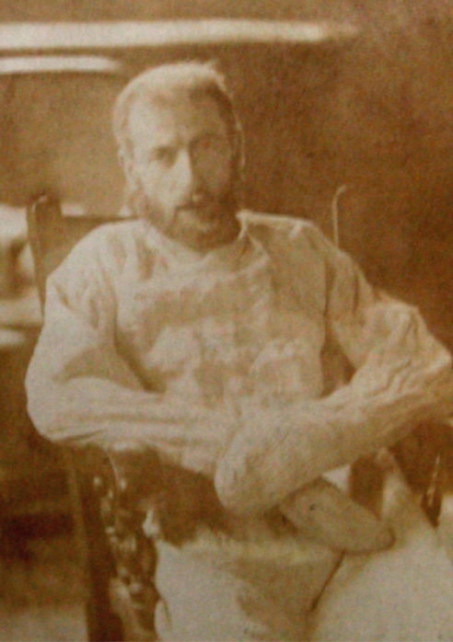
03:
THE RETURN OF RESTRAINT
1880 - 1890
Notes:
Incidents like this were a factor in the return of restraint in the 1880s.

Slide 15
RESTRAINT AT BETHLEM
 | 1866 - 1870 | 1871 - 1875 | 1876 - 1880 | 1881 - 1885 | 1886 - 1888
No. Patients Restrained | 0 | 2 | 12 | 26 | 154
No. Patients in Seclusion | 57 | 73 | 74 | 78 | ?
Notes:
In 1888, Bethlem was subject to a heated debate in the letters pages of the Times, when hospital governor John Charles Bucknill wrote to the newspaper to complain about the increase in restraint used in the wards. Doctors from various institutions wrote to argue for either side. Some held that restraint was cruel and barbaric, comparing it to witch trials as a relic of a brutal past. Others contended that restraint was needed for a range of reasons – to prevent excessive use of sedatives, to protect patients, and to reduce the risk of violence by staff.

Slide 16
“Where the necessity of some form of restraint is indicated you have to choose between the mechanism of a locked glove, or a closed dress, or a padded room; or, on the other side, the mechanism of nature in the shape of two or three burly attendants with strong arms and uncertain tempers. I know which of these tender mercies I would rather submit myself to.”
—Edgar Sheppard, Colney Hatch Asylum 1888
Notes:
Stereotype of “burly attendants with strong arms and uncertain tempers” – middle class assumptions about working class men, always more of a target than female nurses in asylums. And restraint did begin to return.
1890 lunacy act listed the permitted restraints in institutions for first time.
An 1894 survey suggested that the level of restraint had increased, with only 50 of 155 asylums adhering to non-restraint

Slide 17
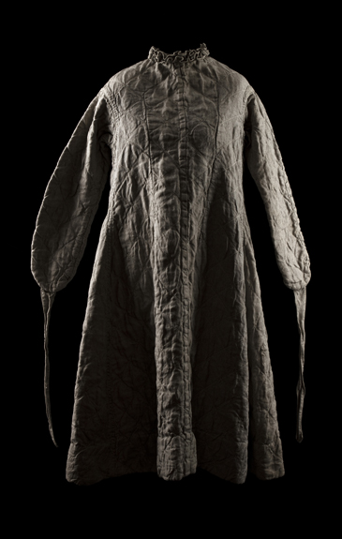
RESTRAINT & UNDERSTAFFING
“We expressed our disapproval of a resort to any form of mechanical restraint with a view to economy of attendants, or simply to prevent destruction of dress or bedding, and advocated frequent intermission of the restraint where employed.”
Bethlem Royal Hospital Annual Report, 1889.
Notes:
Some saw restraint as a worrying trend encouraging increasing understaffing of asylums.
Indeed, the association of mental health staff with protection of suicidal patients, and the negative attitudes towards working class attendants was part of a wider perception that mental health nursing was a lesser form of nursing.

Slide 18
“Considering the present class of persons known as male attendants [in asylums], one can hardly believe that their admission will tend to raise the status of the Association.”
—Ethel Bedford Fenwick, 1896
Notes:
As EBF put it in 1896… Fenwick campaigned for registration in nursing, and set up the RBNA for these purposes. She did not, however, want either the Association or registration to include asylum nurses.
https://rcnarchive.rcn.org.uk/data/VOLUME017-1896/page429-volume17-28thnovember1896.pdf

Slide 19
CONCLUSIONS
1
2
NON-RESTRAINT AS IDEOLOGY V THE PRACTICAL IMPACT ON STAFF
LEGACY OF SUICIDAL BEHAVIOUR AND RESTRAINT PRACTICE
The non-restraint movement had a considerable impact on the lives and work of nurses and attendants in the late nineteenth century
The return of restraint in the 1880s resulted in the reinforcement of restraint “myths” that have been hard to shake off.
Notes:
Non-restraint movement was an ideological intervention by asylum doctors, eager to cast their work as enlightened and humane. But what impact did it have on nursing staff? The constant watching of suicidal patients, and the need to guard their charges from harm even as asylums became domestic settings laid increasing pressure on them, although this was little acknowledged in training and support.
A few years ago, I did a project on the history of restraint with artists at Bethlem. One psychiatrist admitted that he’d never really thought about the topic before, because he personally didn’t have to restrain or manually handle patients. Just as in the nineteenth century, the correct handling and protection of patients was an after thought for some.
And there is a legacy to the negative attitudes to staff and the challenges of managing institutions that saw the return of restraint to English asylums in the 1880s as a so-called protective measure. As Joy Duxbury recently found, three restraint myths still circulate: restraint is protective, restraint is necessary, and restraint is therapeutic. She found no evidence to support these myths however; only evidence against them.

Slide 20
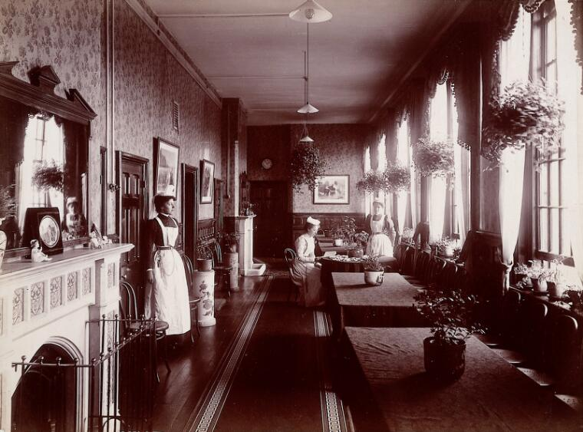
BIBLIOGRAPHICAL REFERENCES
LOUISE HIDE (2014). Gender and Class in English Asylums. Palgrave Macmillan
ANNE SHEPHERD & DAVID WRIGHT (2002). ‘Madness, Suicide and the Victorian Asylum.’ Medical History, 46:2
JOY DUXBURY (2015). ‘Physical restraint: in defence of the indefensible?’ J. Psych & Mental Health Nursing, 22:2
SARAH CHANEY (2017). Psyche on the Skin: A History of Self-Harm. Reaktion
LESLIE TOPP (2018). ‘Single Rooms, Seclusion and the Non-Restraint Movement’ Social History of Medicine, 31:4

Slide 21
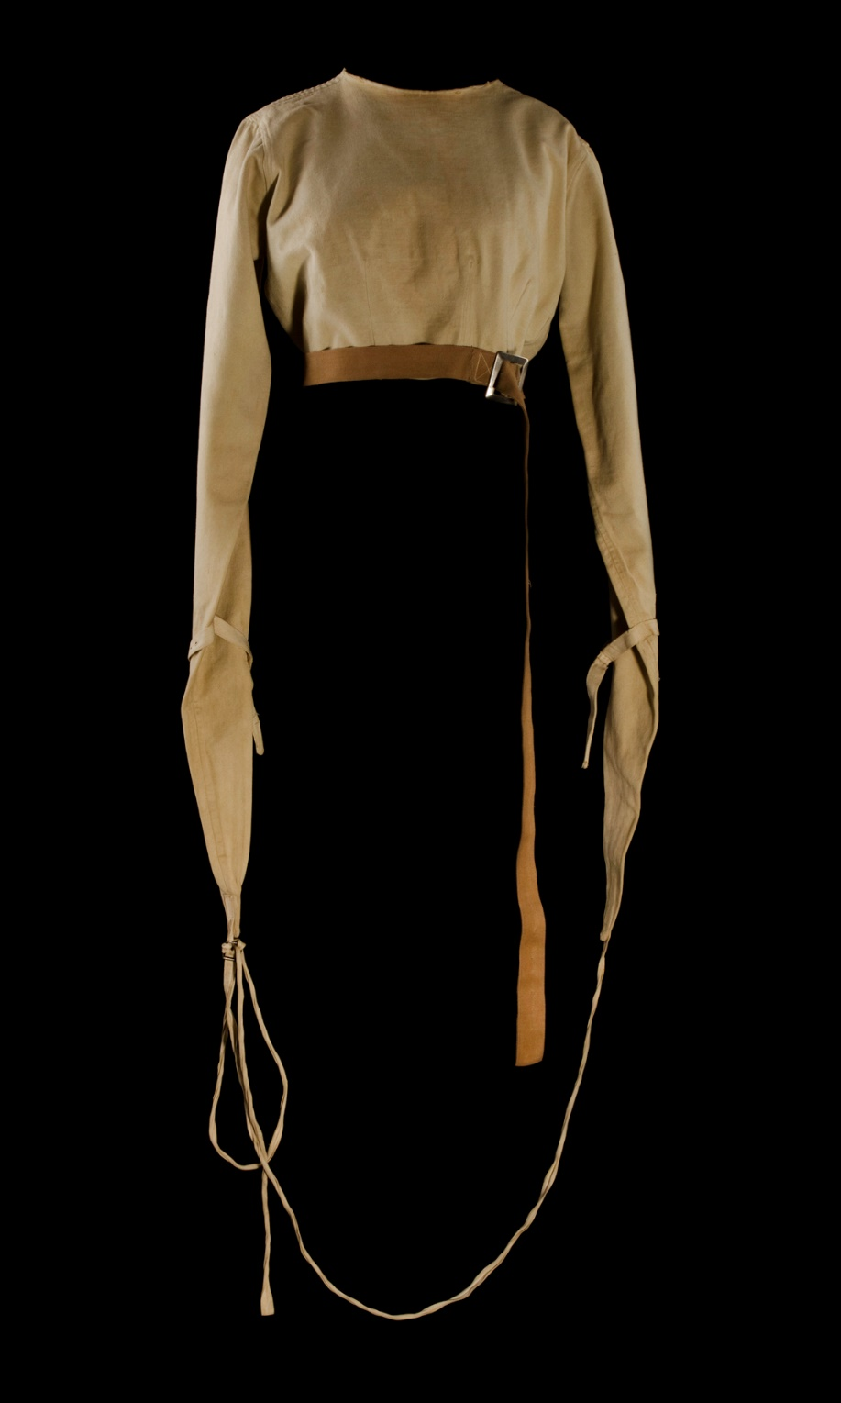
THANKS!
Do you have any questions?
Contact
sarah.chaney@rcn.org.uk
Twitter @kentishscribble
www.rcn.org.uk/whatson
www.qmul.ac.uk/emotions
Image: Jane Fradgley

